Slide 1
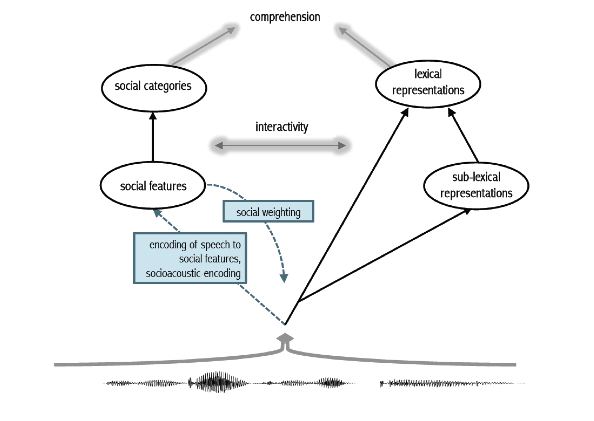

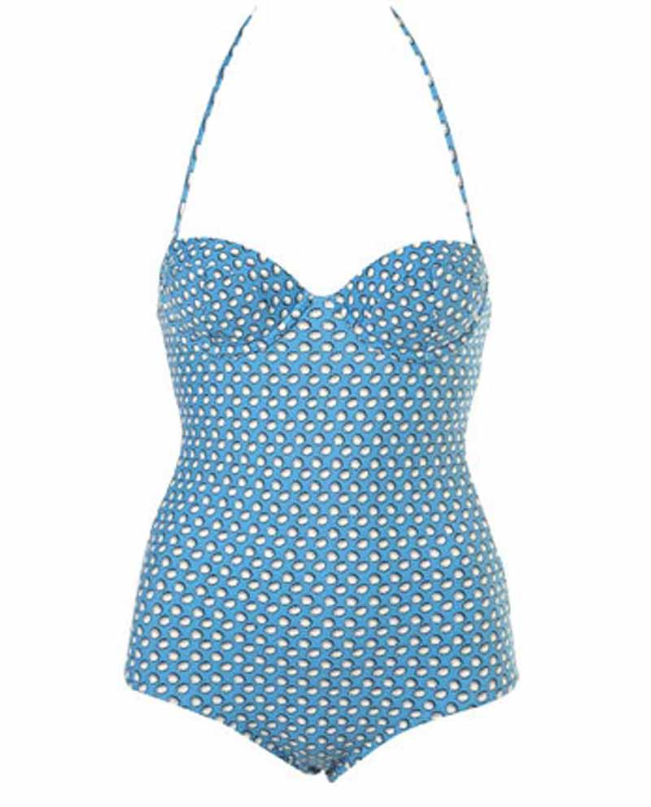
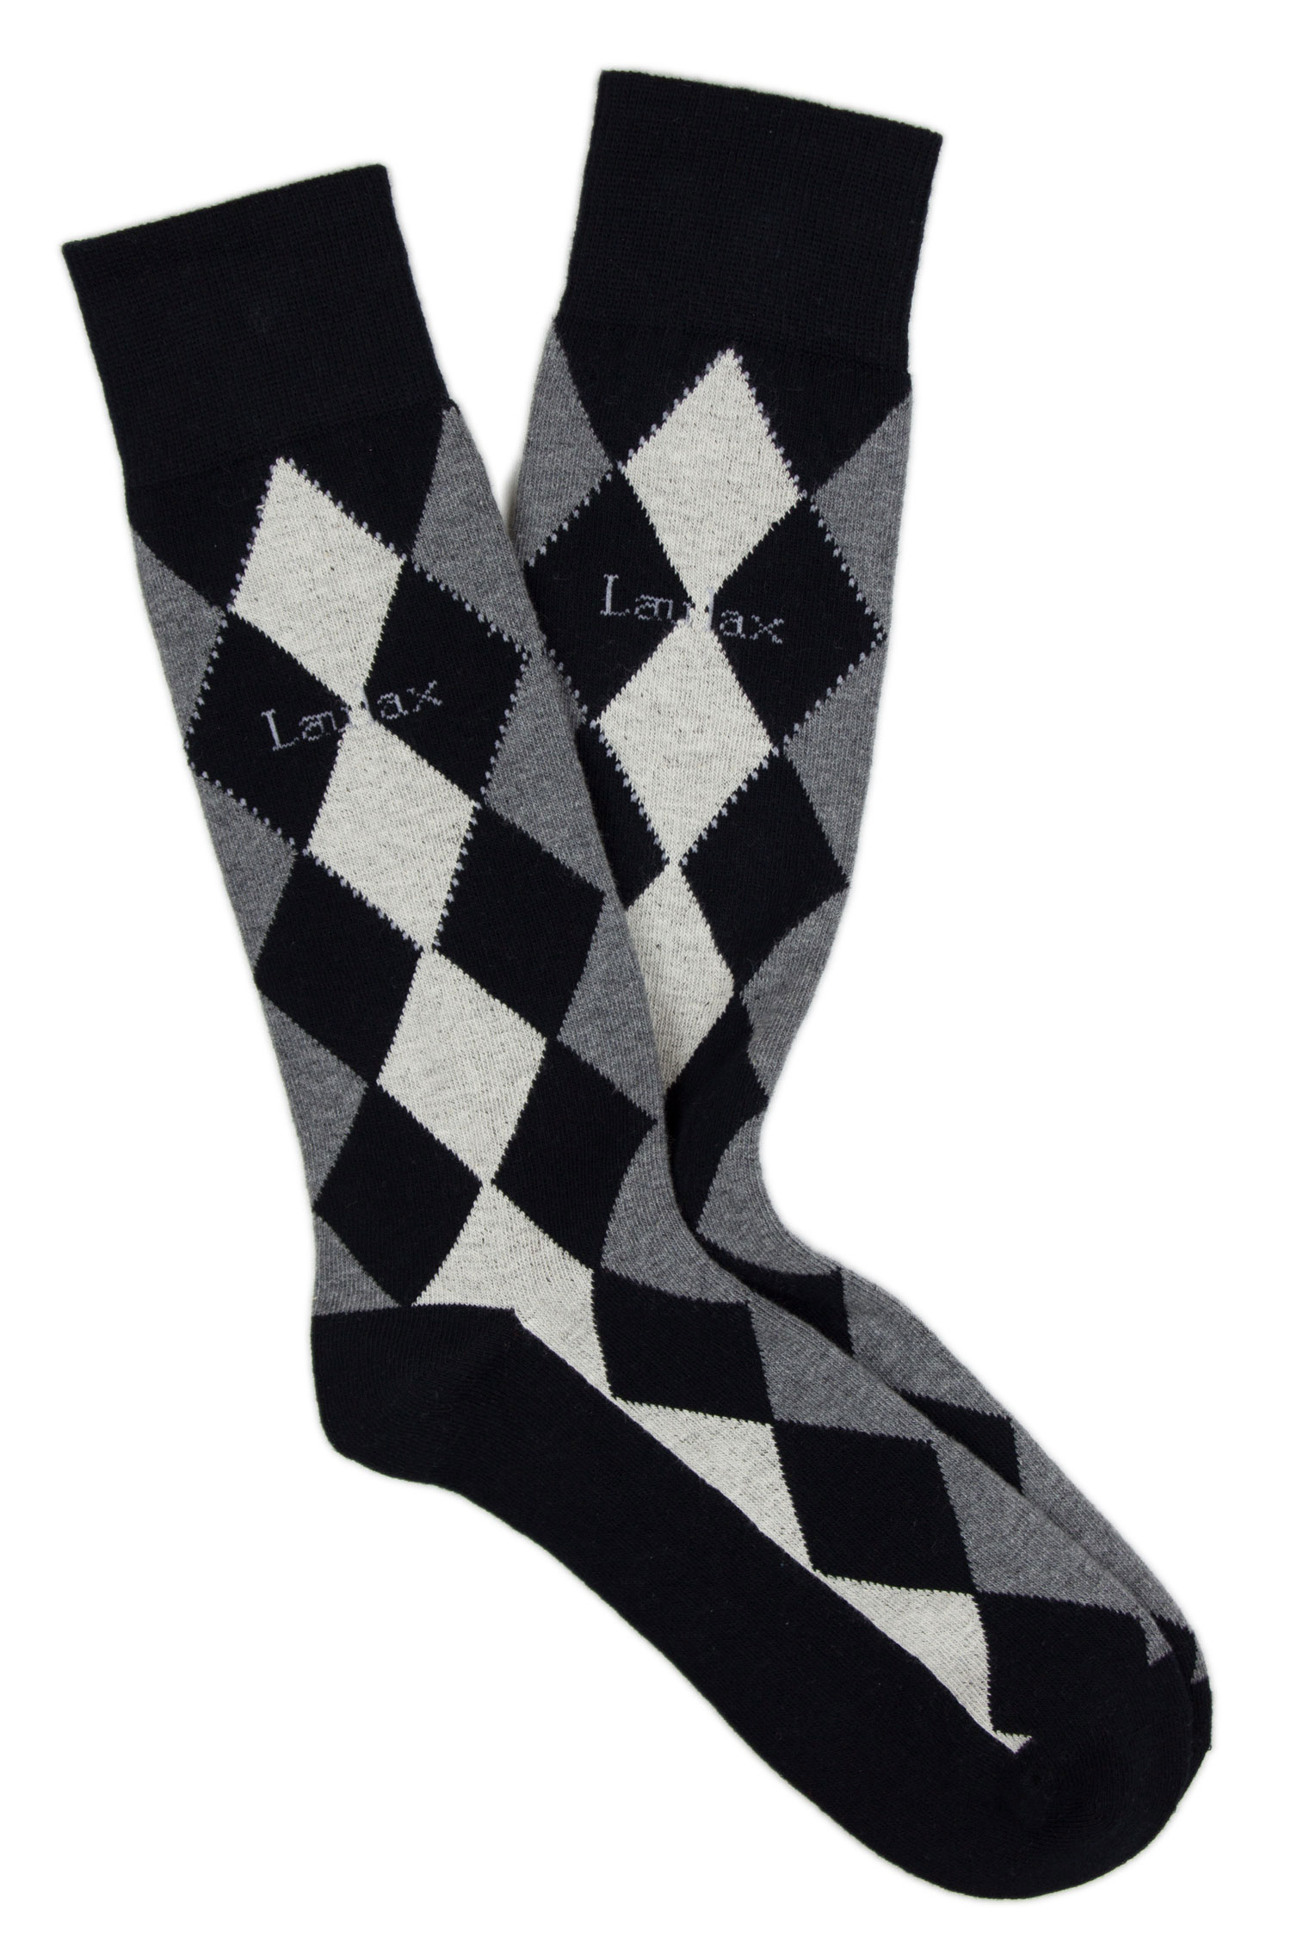


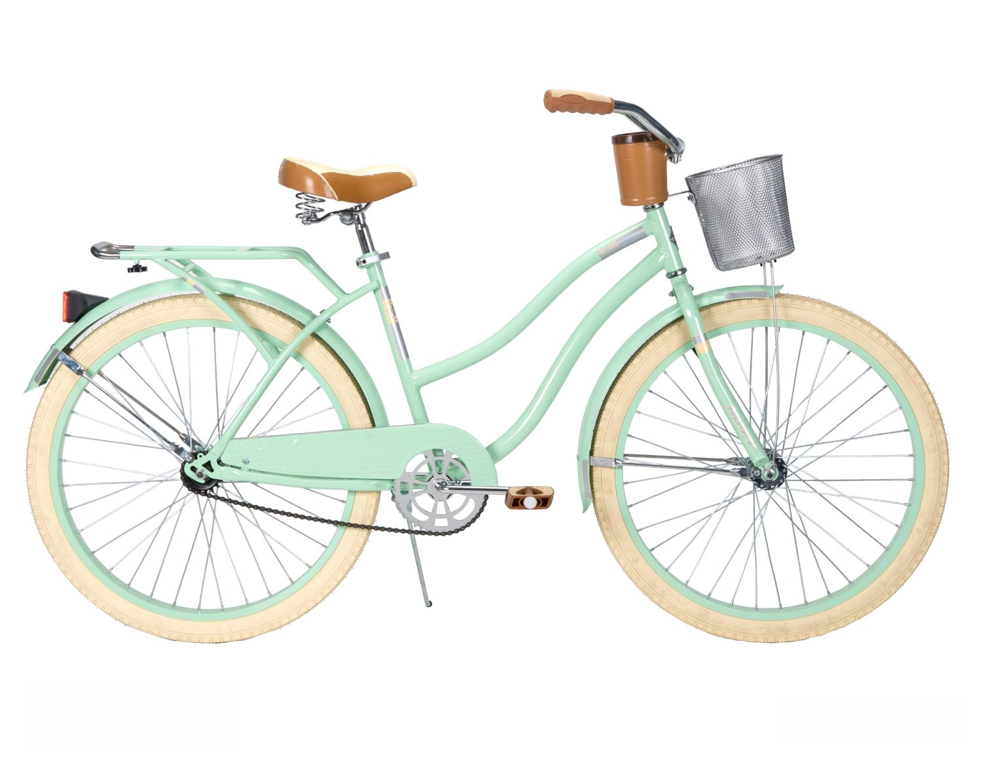
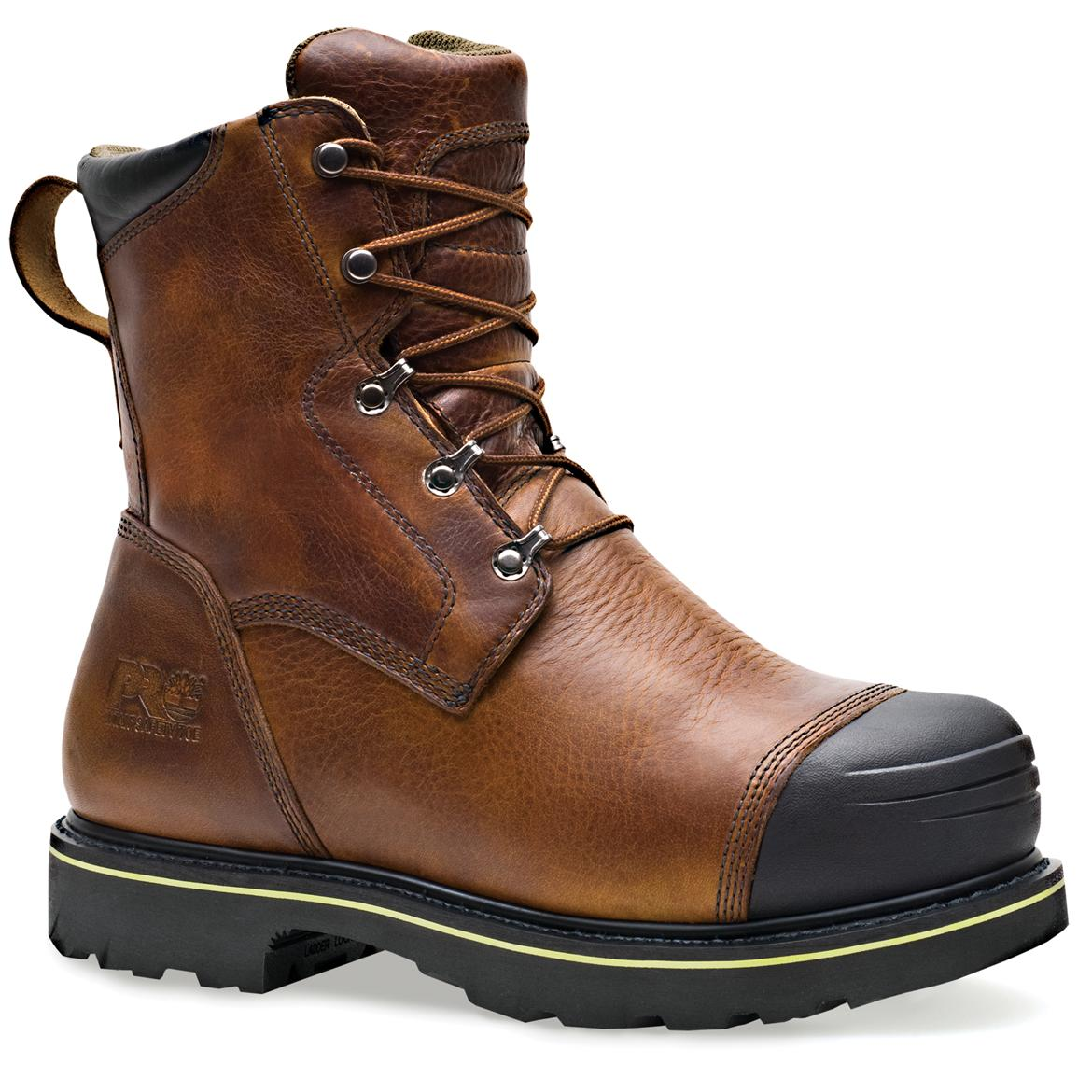
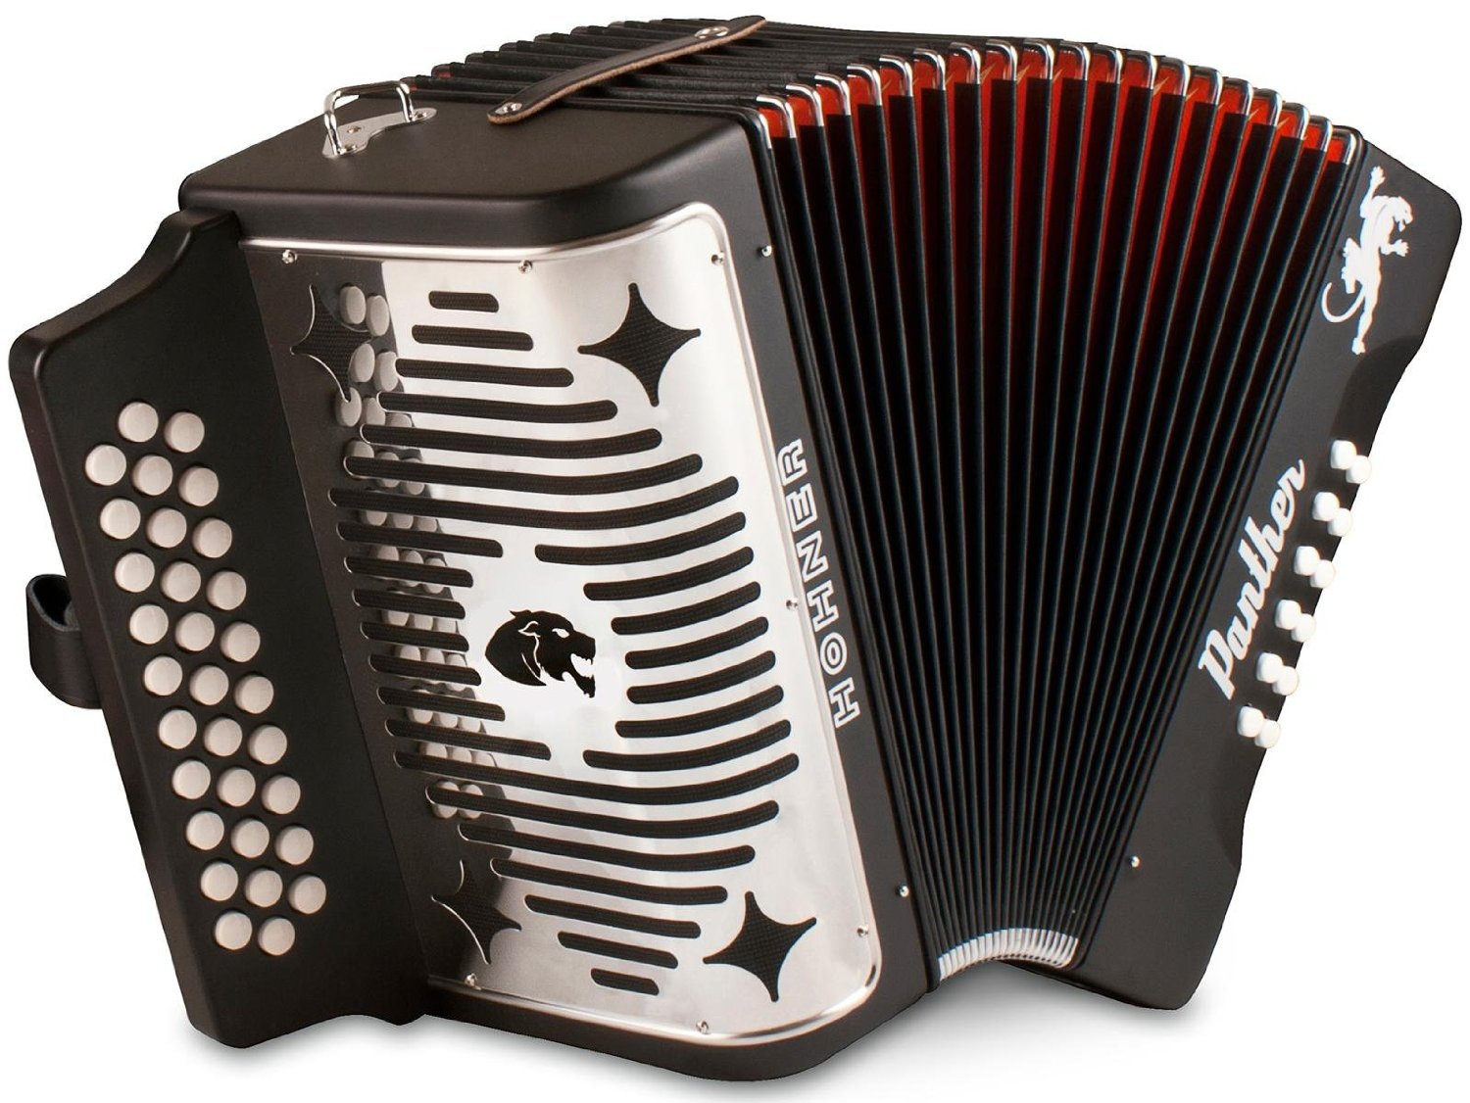
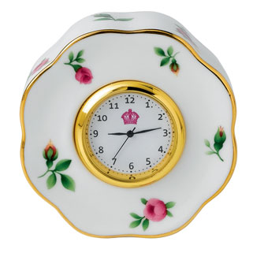
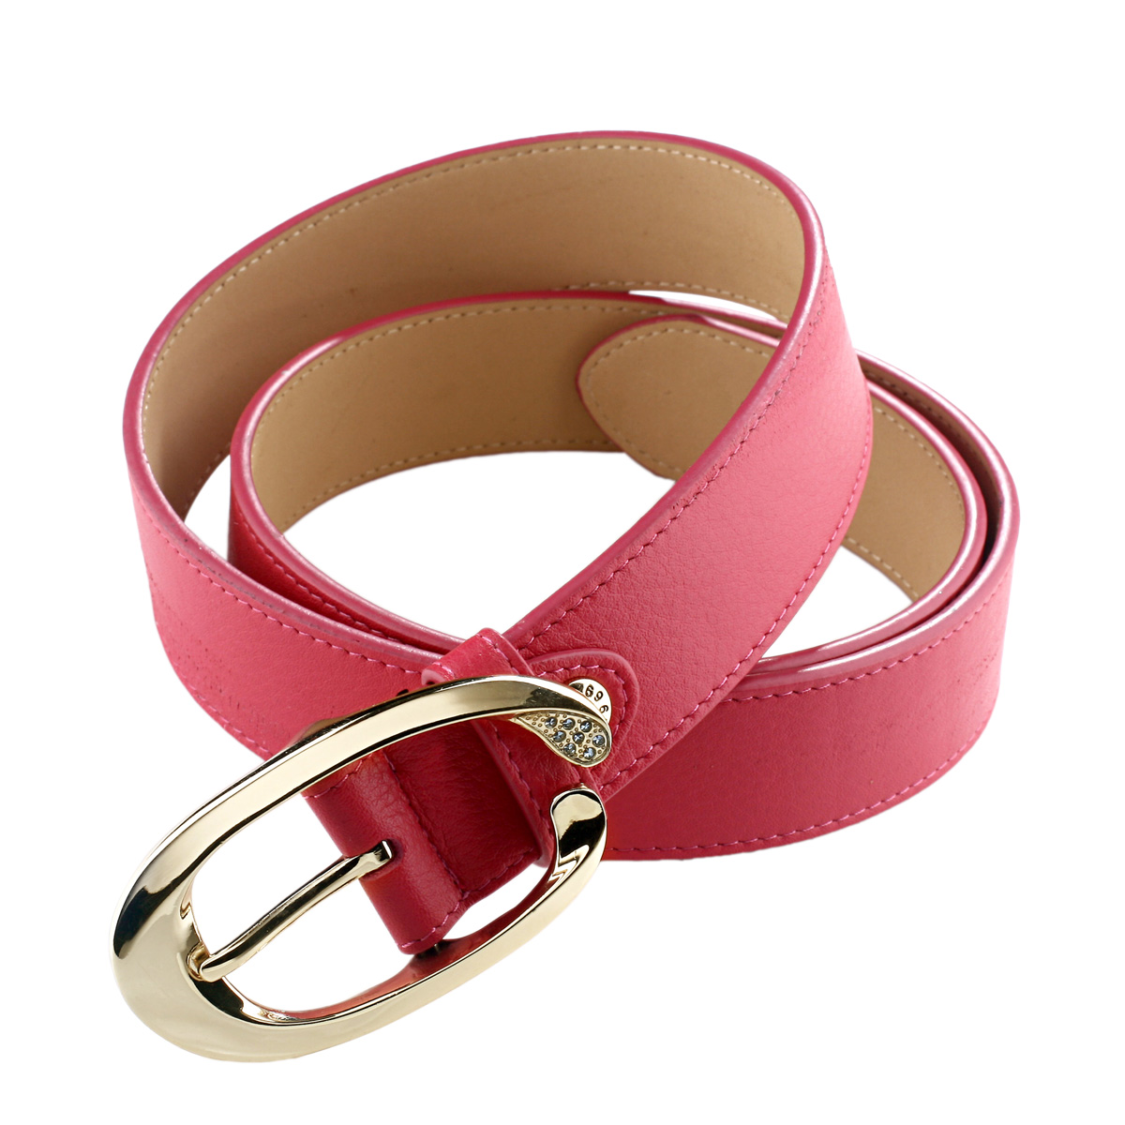



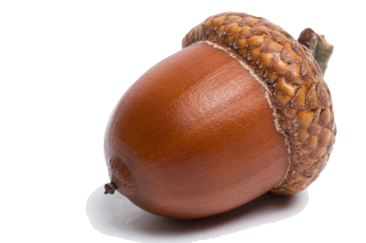

Children Use Phonetically-Cued Talker Information to Infer Speaker Meaning
Nicholas P. Moores, Kevin B. McGowan, Meghan Sumner, & Michael C. Frank
Departments of Linguistics, Psychology • Stanford University
[stæ̃ɱfɚd fənɛɾɨks]
Can children use talker-specific acoustic information (e.g., about gender) to help them interpret ambiguous references?
Background
Experiment 1: Forced Choice
Results: Experiment 1
Model
Find my car. Male Competitor
Do children use phonetically-cued talker information to infer speaker meaning?
By adulthood, listeners use talker information to make social inferences about a talker’s likely behavior (Van Berkum et al., 2008), especially when they expect talker identity to be useful or find it to be a reliable cue (Creel, Aslin, & Tanenhaus, 2008).
Recent work suggests that children use acoustic cues to talker identity to constrain comprehension of spoken language (Creel, 2012), though the way in which children learn to integrate social knowledge with information from talker voice remains poorly understood.
Find my boot. Male Non-Competitor
Discussion
Strong use of talker information to facilitate comprehension
In competitor trials, as age increases, children are more accurate in disambiguating the voice cues.
Interestingly, girls are more accurate in disambiguating the voice cues than boys in this experiment.
These preliminary results suggest that children make use of socially-nuanced talker-specific acoustic information by a young age, and that children’s use of talker-specific acoustic information pertaining to gender may differ between boys and girls.
From ages 3 to 5, the ability to disambiguate increases significantly. By the age of 5, children regularly integrate phonetically –cued talker information with their social knowledge of speaker characteristics (4 year olds: β=0.84, SE=0.24, z=3.453, p < 0.001; 5 year olds: β=.86, SE=0.27, z=3.158, p < 0.01). (N=50)
Female participants are significantly better at the task than male participants (β=0.5.7, SE=0.21, z=2.762, p < 0.01). (N=50)
Hypothesis
Children should get better at using talker information in voice as a predictor of speaker meaning as they get older
Find my belt. Female Competitor
The data suggest children were always faster to select during non-competitor trials than during competitor trials (β=-0.45, SE=0.20, t=-2.225, p<0.05). (N=50)
Method
3-, 4-, 5-year old preschool boys and girls interact with slides on an iPad (N=50).
Subjects hear speakers in two blocks, one male and one female.
Subjects are asked by speaker to find my ____.
To the right are examples of the four types of trials a subject will experience.
Find my bike. Female Non-Competitor
References
Creel, S. C., Aslin, R. N., & Tanenhaus, M. K. (2008). Heeding the voice of experience: The role of talker
variation in lexical access. Cognition, 108, 633-664. Creel, S. C. (2012). Preschoolers' Use of Talker Information in On-Line Comprehension. Child development, 83,
2042-2056. Jaeger, T. F. (2008). Categorical data analysis: Away from ANOVAs (trans- formation or not) and towards logit mixed models. Journal of memory and language, 59(4), 434-446.
Johnson, K. (2006). Resonance in an exemplar-based lexicon: The emergence of social identity and phonology.
Journal of phonetics, 34, 485-499. Sumner, M., Kim, S. K., King, E. & McGowan, K. B. (2013). The socially weighted encoding of spoken words: a dual-route approach to speech perception. Frontiers in psychology, 4.
Van Berkum, J. J., van den Brink, D., Tesink, C. M., Kos, M., & Hagoort, P. (2008). The neural integration of speaker and message. Journal of Cognitive Neuroscience, 20, 580-591.
This material is based upon work supported by a Stanford UAR Major Grant to Nicholas P. Moores
Any opinions, findings, or conclusions expressed in this material are those of the author and do not necessarily reflect the views of Stanford UAR.
Questions? E-mail Nicholas (npmoores@stanford.edu)

